Slide 1
ImageData Augmentation
Short Story Assignment - CMPE 258 Deep Learning
Harika Nalam
015939963

Slide 2
Why Data Augmentation
Deep learning has been shown to be effective in a variety of computer science fields. The availability of large datasets is critical for deep learning models. Certain fields, such as medical image processing, do not have access to vast amounts of evidence. This pandemic was the driving force behind this survey.
Reason-
When compared to traditional data gathering with label annotation, it is a cost-effective practice.
It is incredibly accurate, as it is created from natural ground-truth data.
It can be controlled, which aids in the generation of balanced data.
It aids in the solution of the overfitting problem.
It aids in the attainment of higher testing accuracies.

Slide 3
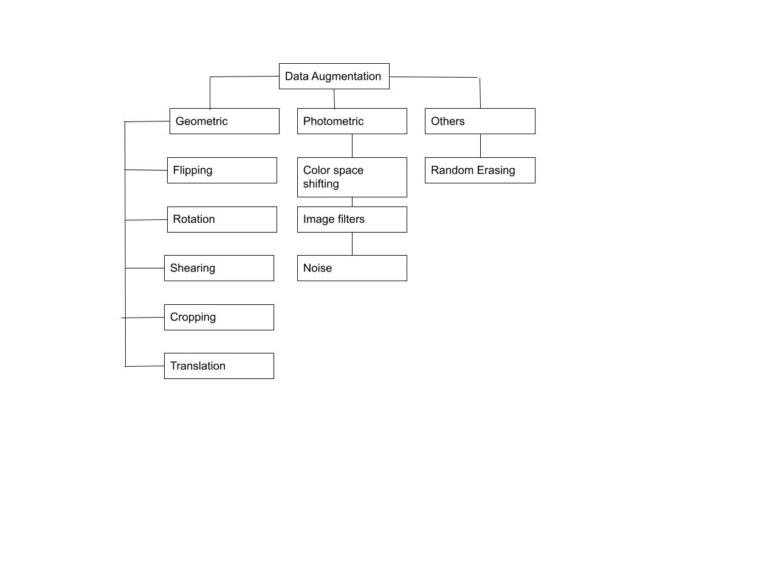
Classical Image data augmentation

Slide 4
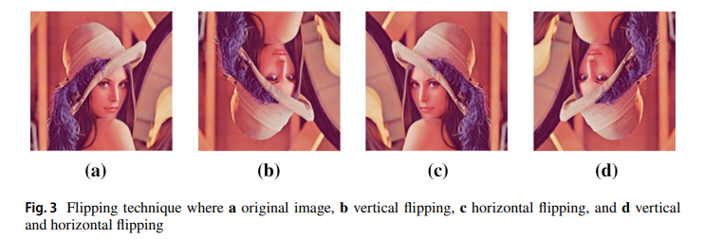
FLIPPING
Horizontal Flipping
Vertical Flipping
Horizontal Vertical Flipping

Slide 5
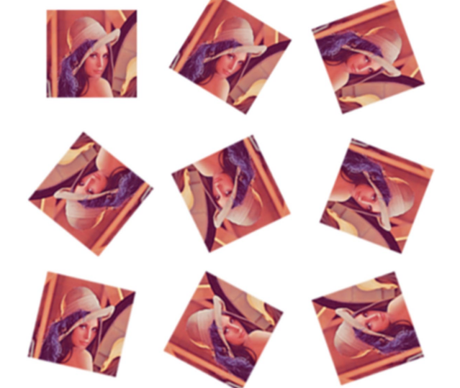
ROTATION
rotating the image along an axis
In the right or left direction
Angles ranging from 1 to 359

Slide 6
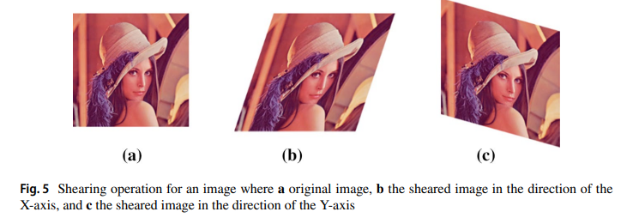
SHEARING
Changing the original image in both the x and y directions
Shearing is divided into two categories
Along x-axis
Along y-axis

Slide 7
CROPPING
Zooming
Scaling

Slide 8
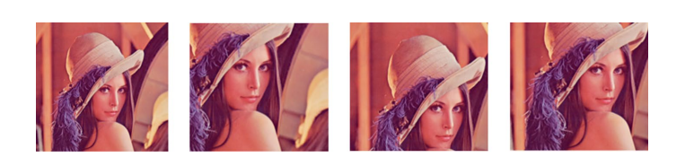
TRANSLATION
Process a shifting an object a picture from one position to another.
Translation can be done in X or Y directions.

Slide 9
COLOR SPACE SHIFTING
It is a Photometric data augmentation.
There most famous color spaces are -
• CMY(K) {Cyan — Magenta -Yellow — Black}.
• YIQ, YUV, YCbCr, YCC {Luminance / Chrominance}.
• HSL {Hue — Saturation — Lightness}. • RGB {Red — Green — Blue}.

Slide 10
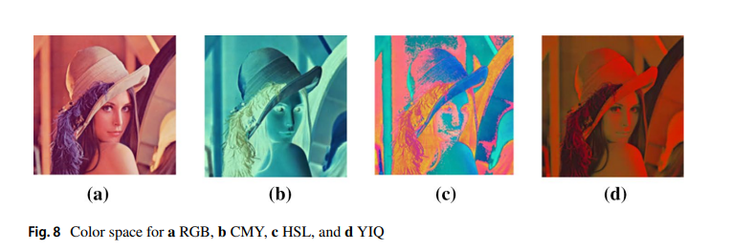
Image Filters
Brightness enhancement
Sharpening
Blurring
Histogram equalization

Slide 11
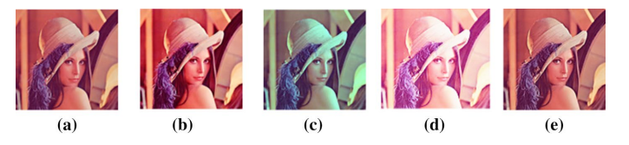
Noise
Gaussian Noise

Slide 12
GAN-based Data Augmentation
Generative modeling refers to creating instances from a dataset
Gan leading in computation speed and quality of results.
GANs to Data Augmentation and reporting the resulting classification performance has been done in biomedical image analysis
GAN Architecture
Generator Network
Discriminator Network

Slide 13
State of Art Data Augmentation Techniques
Neural Augmentation
Use neural layers to translate images into new styles
Better performance technique than traditional color space augmentation
Auto Augmentation
Reinforcement learning Algorithm
This algorithm search for an optimal augmentation policy among constrained set of geometric transformations
Smart Augmentation
Similar to Neural Augmentation
Use adaptive CNN to derive new images rather than averaging pixels

Slide 14
Comparing Augmentation Techniques
Data Augmentation Techniques Compared using dataset sizes of
small set( with around 2k samples)
medium set(with around 10k samples)
large set (with around 50k samples)
Three level of data augmentation
No augmentation
Original + generated samples
Original + double size of generated samples
From different techniques with different size datasets, Cropping, Flipping and rotation performed best.

Slide 15
Image Data Augmentation within different domains
Medical Domain
Agricultural Domain
Remote Sensing Domain

Slide 16
Thank You

